Slide 1
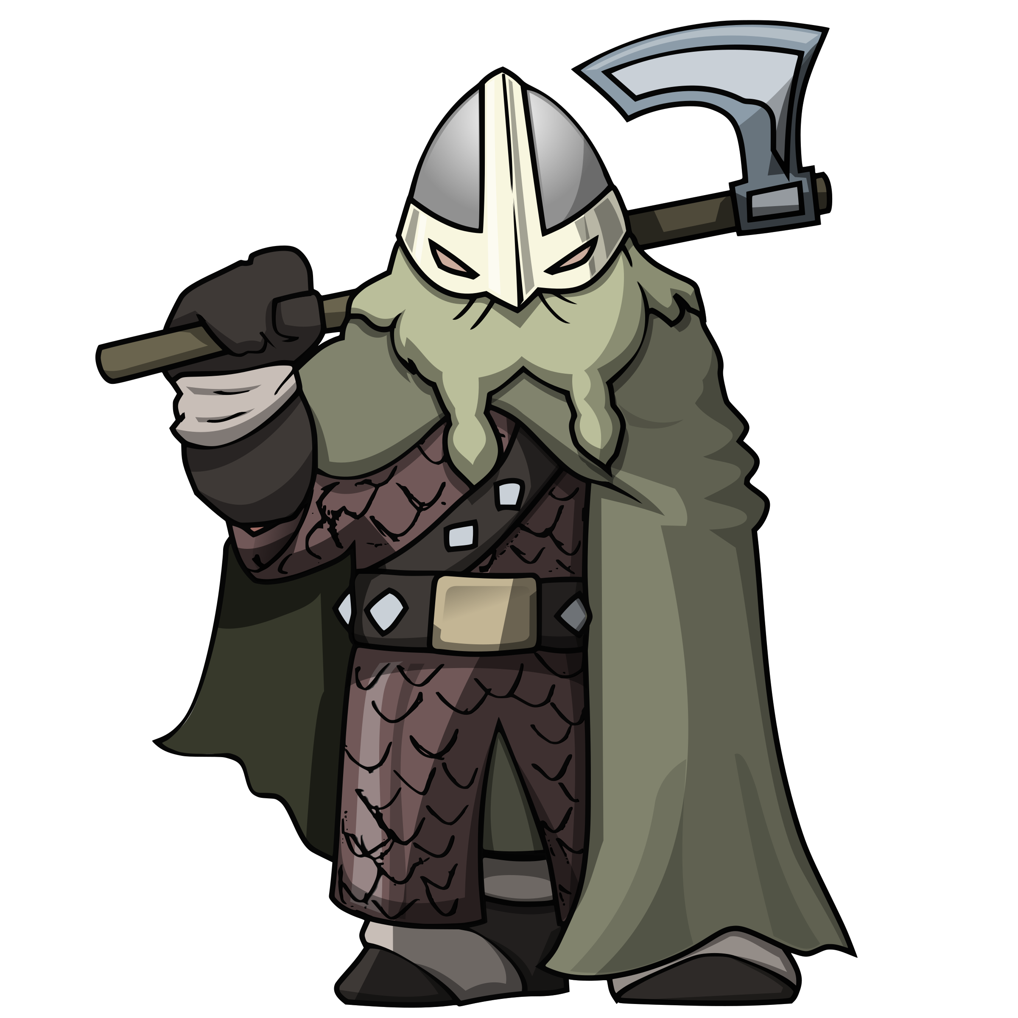







Kite Class Termly Topic Tasks
Follow your interests and choose at least one task to complete at home this half term. We will celebrate and share these in class. How you present them is up to you – you can be as creative as you like!
Night and day Explain how night and day on Earth works to an alien. | Healthy Living Keep a food diary for a week. Are there any ways you think you could make your diet healthier? Choose one and try it for next week. | History Research a famous Viking and write a biography about them. | Music Listen to one of the pieces of music from Holst’s planet suite. Do you like it? Does it remind you of anything? Now, have a go at composing your own piece of music to represent one of the planets.
Art Create an artistic interpretation of one of the planets. | Keeping Safe Now it’s getting daker on an evening, what would your top tips for keeping safe out and about be? | Dance Choreograph a dance that represents one of the planets. | Celebrations Lots of festivals are held in Autumn and Winter. Can you research a religious festival and create something inspired by it to share with the class?

