Slide 1
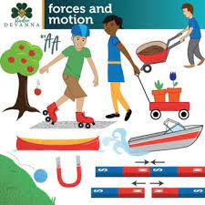
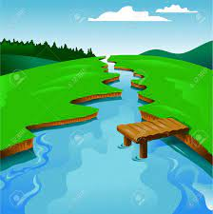






Kite Class Termly Topic Tasks
Follow your interests and choose at least four tasks to complete at home this term. We will celebrate and share these in class. How you present them is up to you – you can be as creative as you like!
Forces Plan an experiment based around forces. | Healthy Living Plan a fitness circuit at home using everyday objects and try do it 3 times in a week. | Geography Research a famous river and create a fact file about it. | Music Compose a piece of music inspired by water/a river. Think about how you will use different timbres (unique sound) and dynamics (loud/quiet) to represent the different parts of a river.
Art Create an artistic interpretation of a river. | Keeping Safe Write a guide to crossing the road safely for a younger child. | Dance Choreograph a dance that represents a river. | DT Design a product to help keep an explorer’s belongings dry on a river voyage. Think carefully about what materials you would use and how you would connect them together.

