Slide 1

Theme Park Project

Slide 2
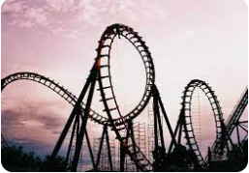
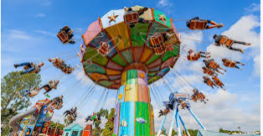
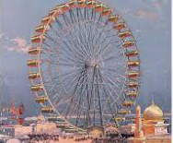
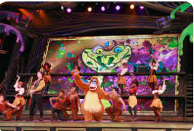
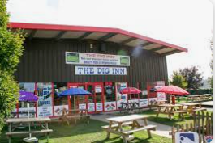
Ideas
A theme park is a place which bring fun and excitement to the whole family. The park contains thrilling and exciting rides; games and challenges to complete; shows to entertain and spaces to relax and eat.

Slide 3
Design
Your challenge is to design your own theme park. How will the space be used in you park and what will you include to ensure the whole family enjoy their visit.
You could use a computer to research theme park designs and lay out and to look at pictures.
Have you been to a theme park before? What can you remember about the design?

Slide 4
Making
Use your design to create a 3D model of your theme park.
You could use lego, cardboard, paper, pipe cleaners, spaghetti – any media you think will work well to create your design.

Slide 5
Evaluation
When you have finished your 3D creation, look critically to evaluate it.
What has worked well?
What did not work as planned?
What would you do differently next time?
What could you do to make this even better?

