Slide 1

Mixed Age STEM activities
Taken from the website50+ STEM activities for any classroom
https://www.stem.org.uk/news-and-views/news/50-stem-activities-any-classroom

Slide 2
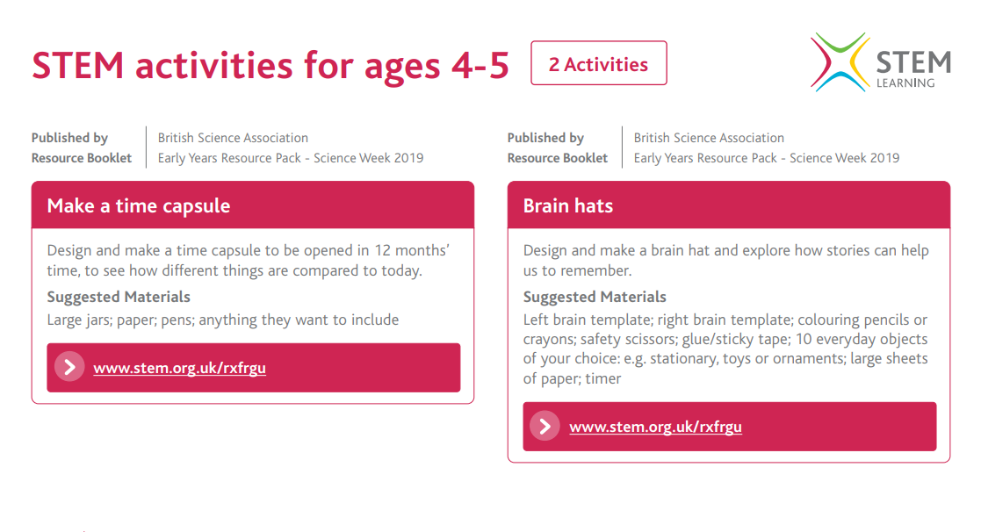

Slide 3
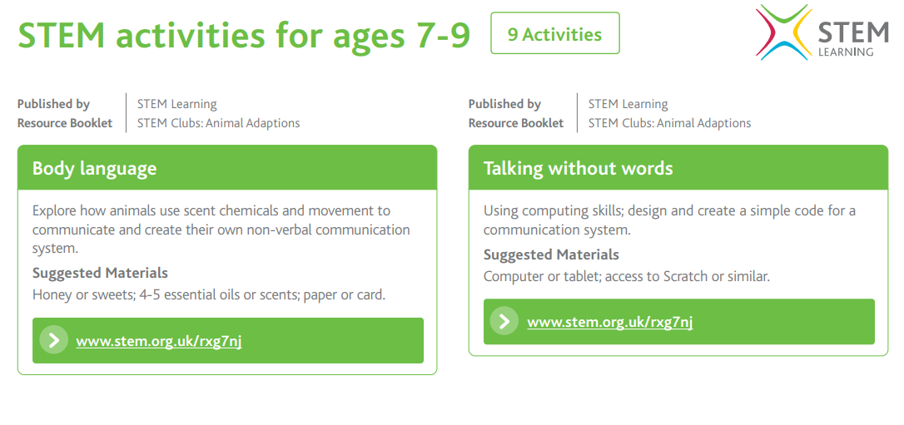

Slide 4
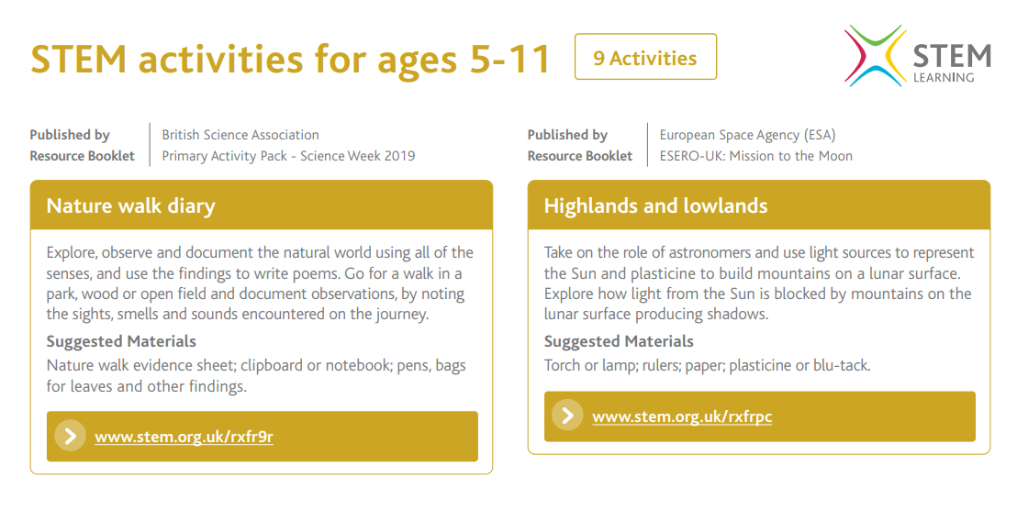

Slide 5
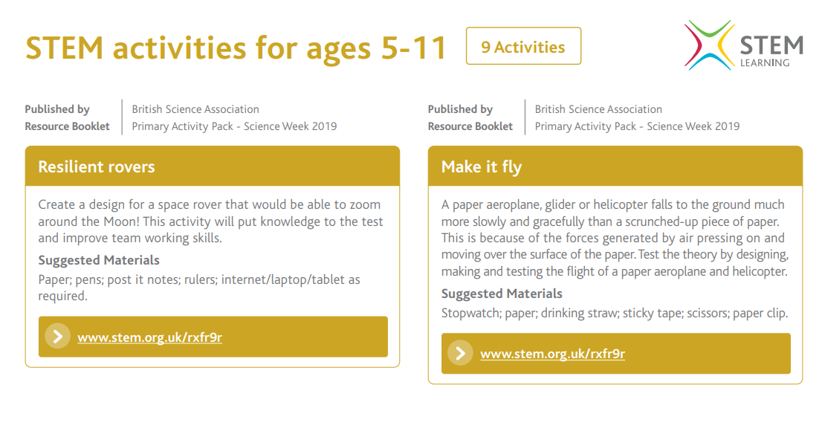

Slide 6
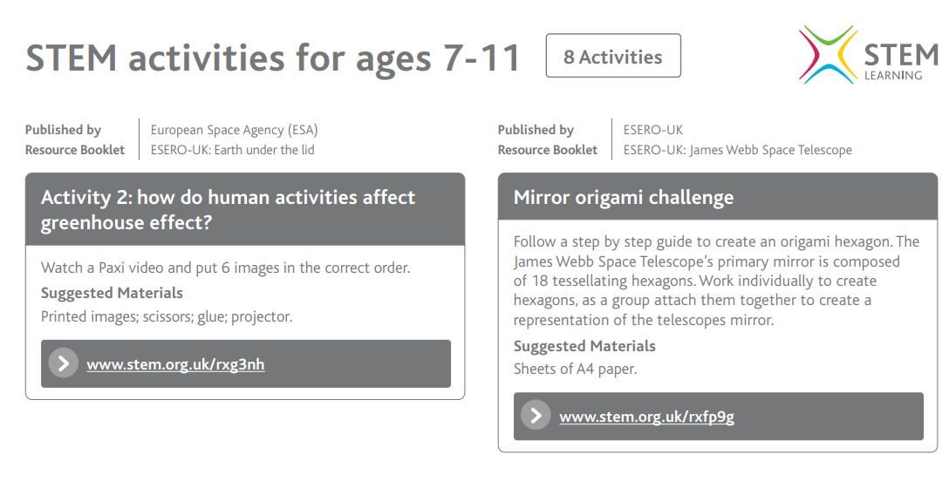

Slide 7


