Slide 1

What we will learn …
Y6 curriculum

Slide 2
The usual …
Writing
Reading
Maths
Grammar
Spelling
Times Tables

Slide 3
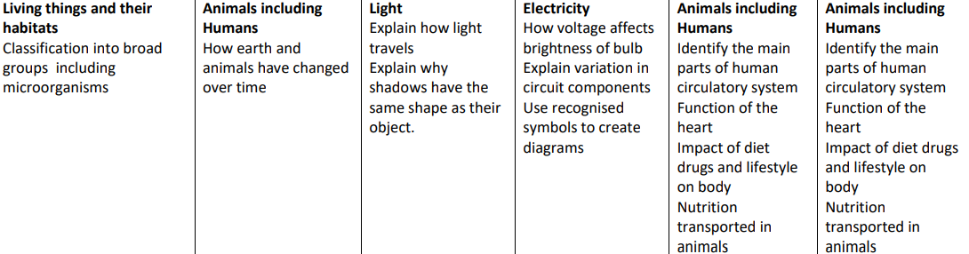
Science

Slide 4
Computing

Slide 5
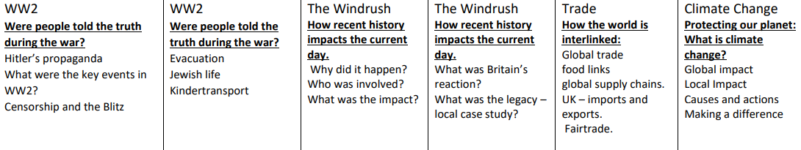
Geography and History

Slide 6
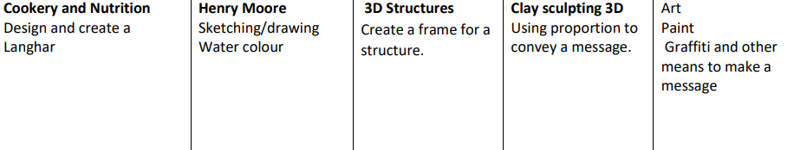
Art and DT

Slide 7
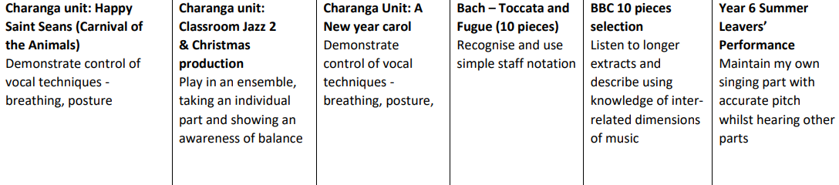
Music

Slide 8
French

Slide 9
RE

Slide 10
PE

Slide 11
Questions …

