Slide 1
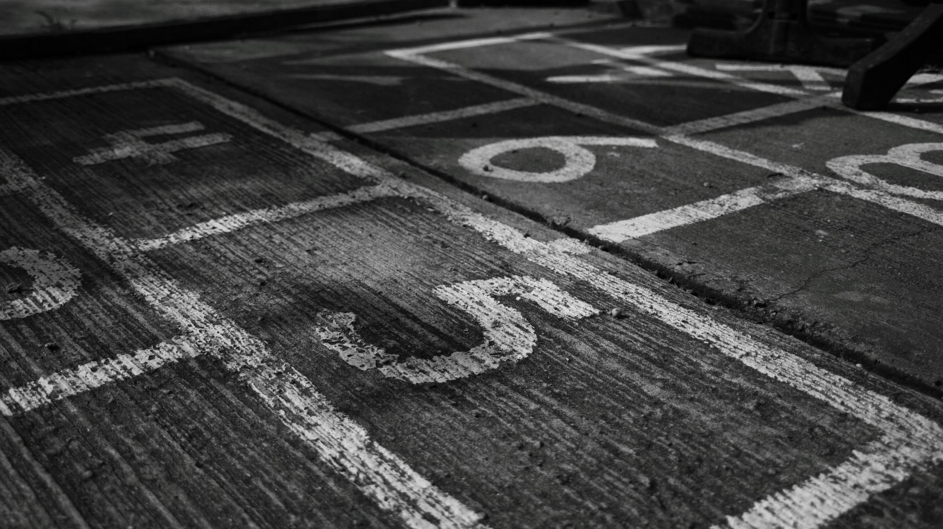
Year 6
Things we will do …

Slide 2
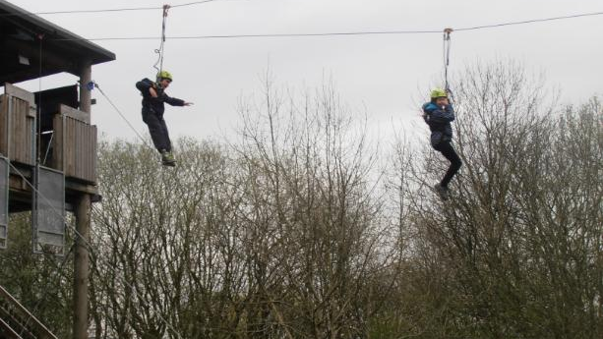
Robin Wood Residential (Oct)

Slide 3

Class assembly (Oct)

Slide 4
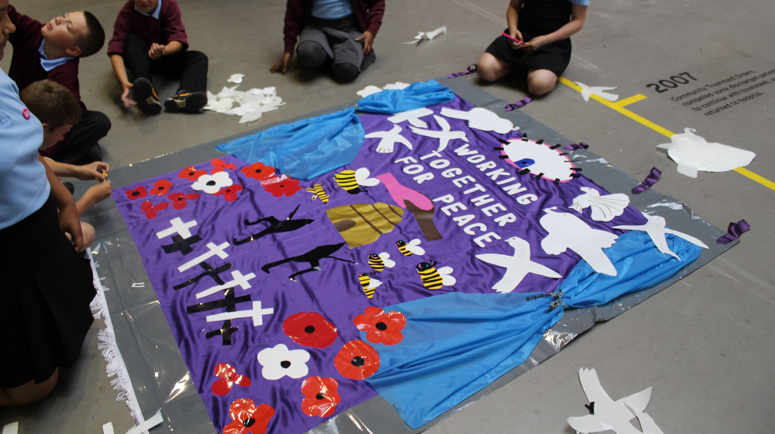
Peace Museum (in school – Nov)

Slide 5
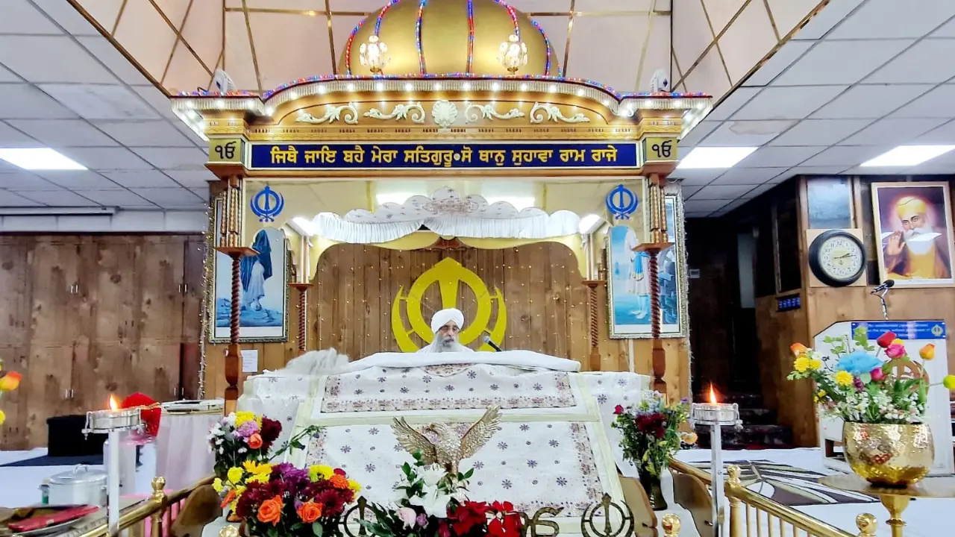
Gurdwara Visit (Dec)

Slide 6

Christmas Performance (Dec)

Slide 7

Christmas Party (Dec)

Slide 8

SATs (May)

Slide 9
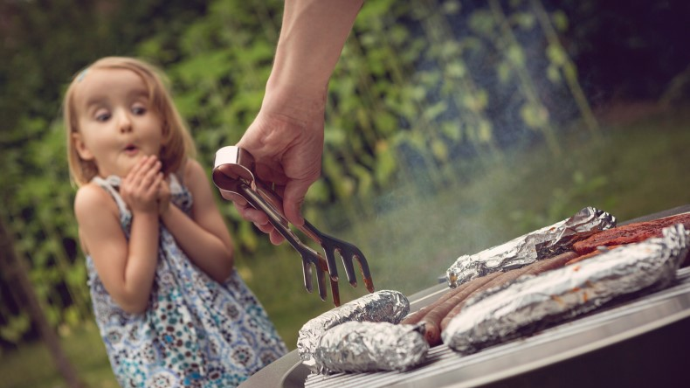
BBQ (July)

Slide 10
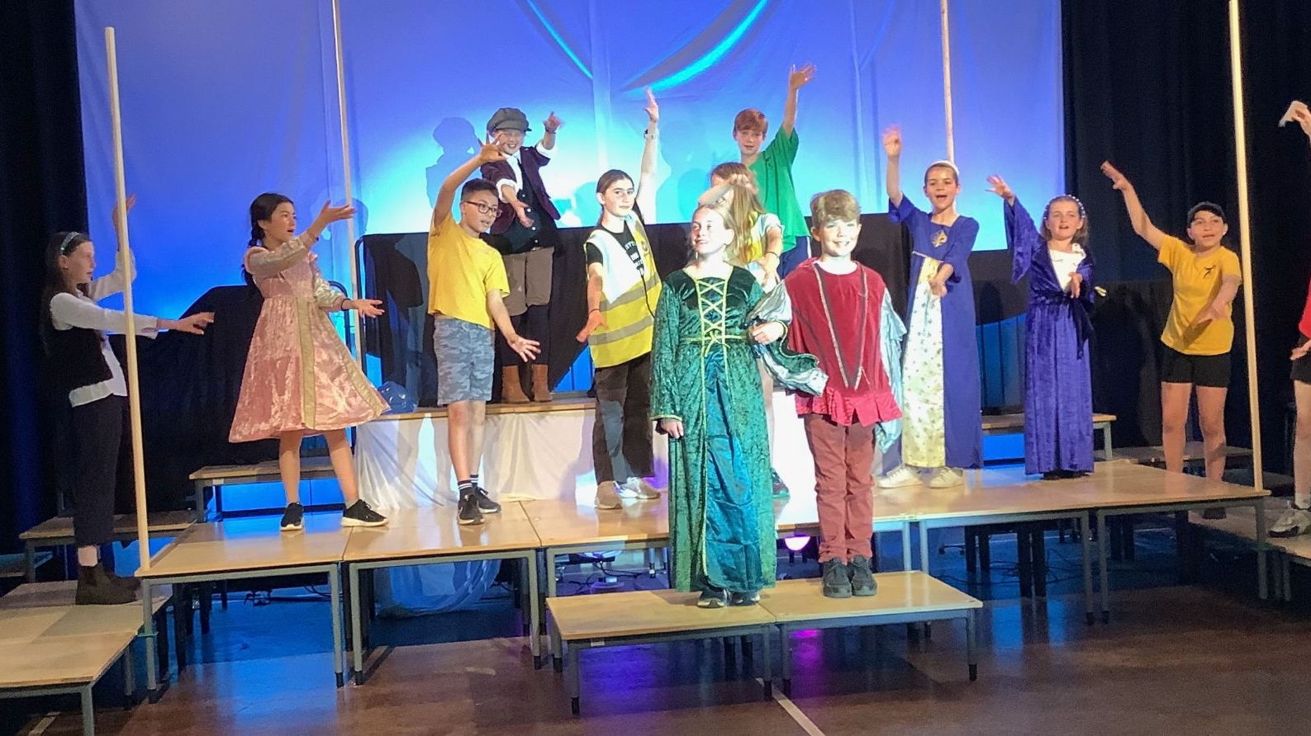
Leaver’s Concert (July)

Slide 11
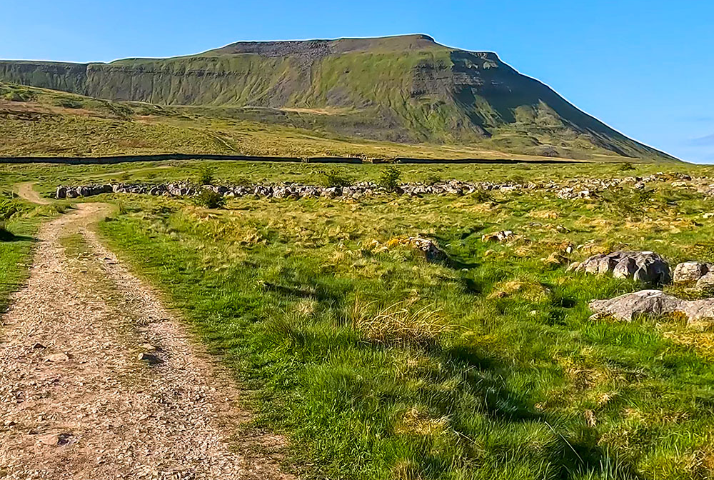
Ingleborough Walk (July)

Slide 12

Leaver’s celebration assembly (July)

Slide 13

Clap out Y6 (July)

Slide 14
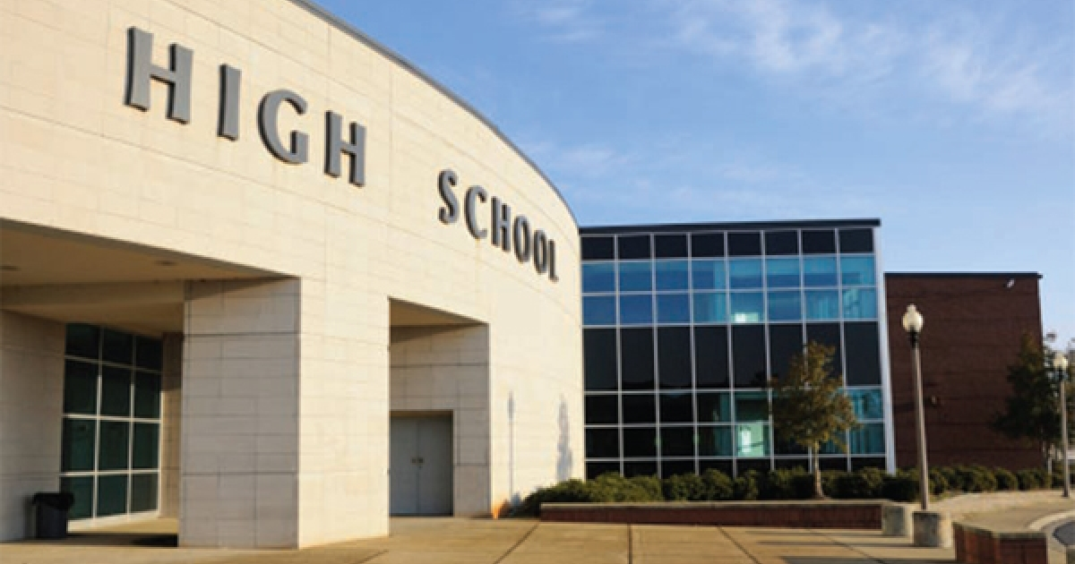
Start high school (Sept)

Slide 15
Questions
Leavers hoodies – when?
Doodle books?
Phones?

