Slide 1
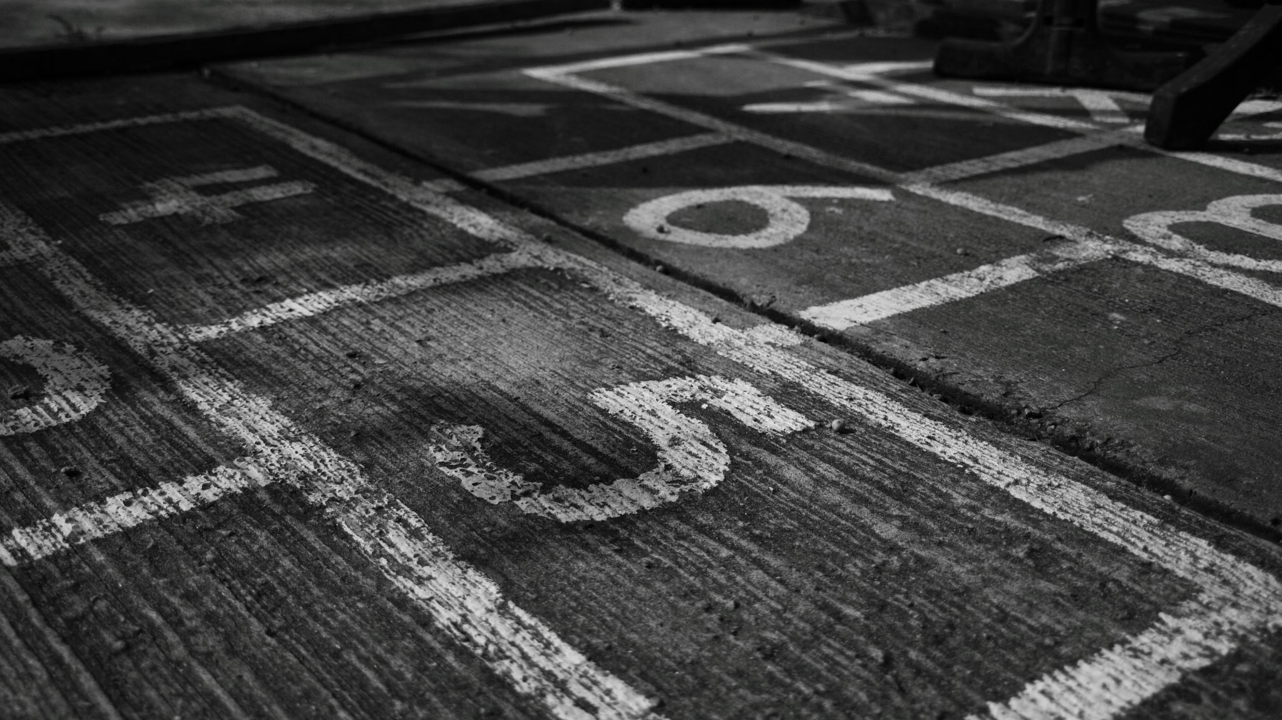
Year 5
Things we will do …

Slide 2
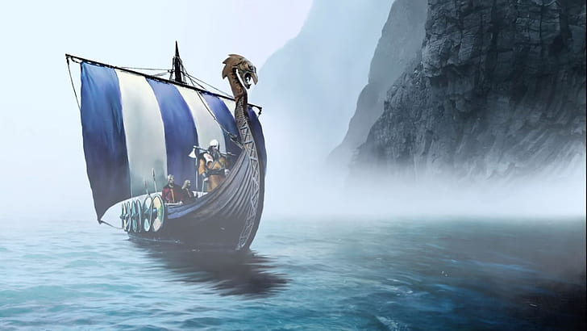
Viking Visitor(in school - Dec)

Slide 3

Christmas Performance (Dec)

Slide 4

Christmas Party (Dec)

Slide 5
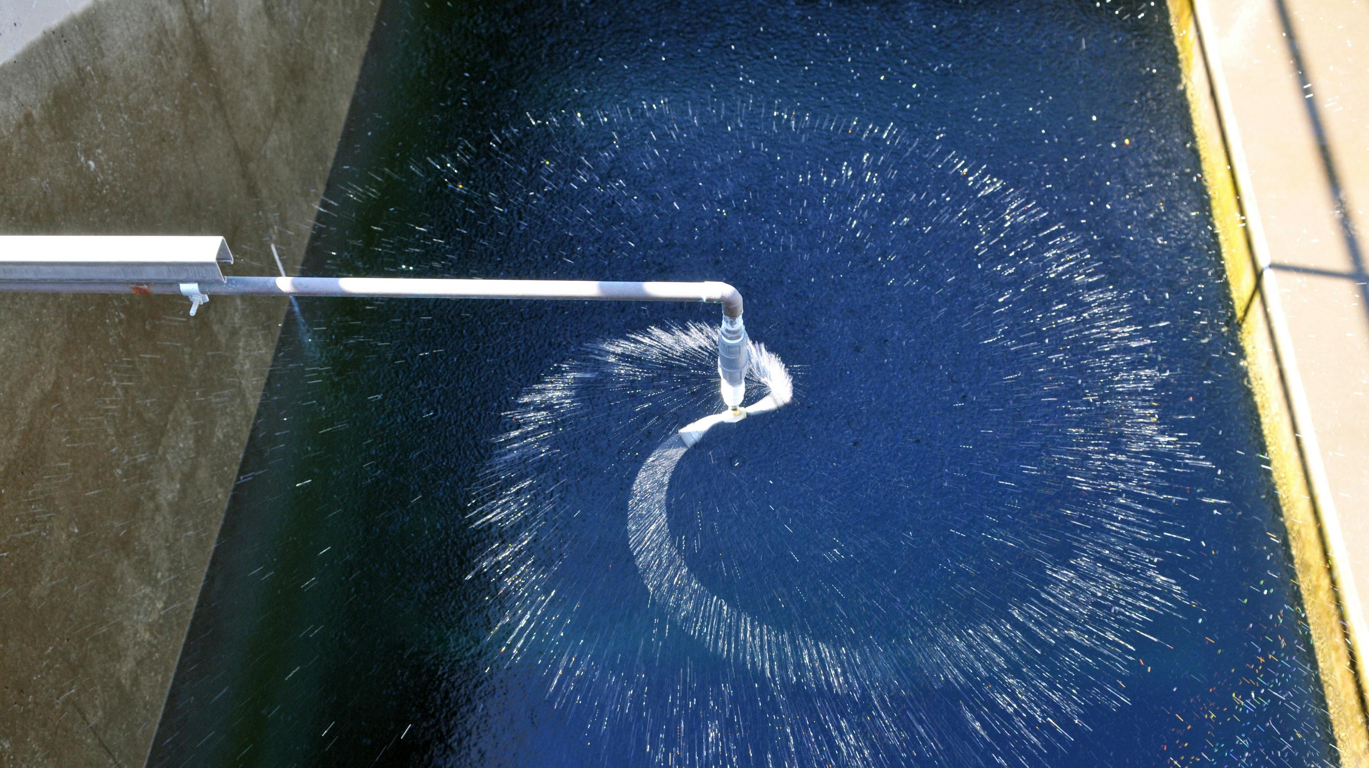
Water Treatment Center trip (Feb)

Slide 6

Class assembly (May)

Slide 7
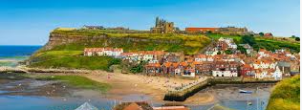
Whitby Trip (June)

Slide 8
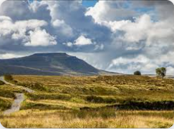
Whernside Walk (June)

Slide 9
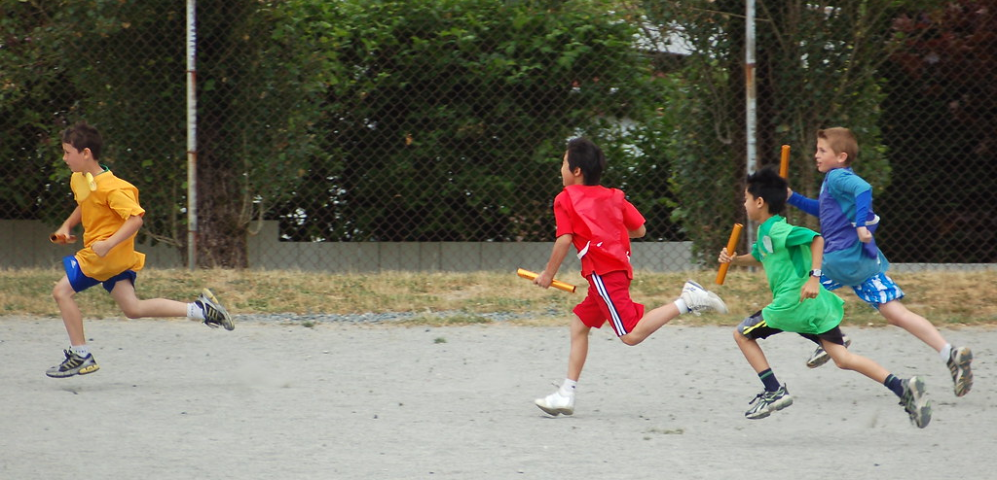
Sports Day (July)
This Photo by Unknown Author is licensed under CC BY-NC

Slide 10
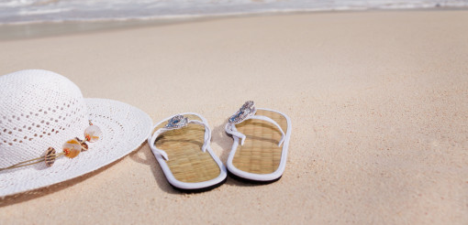
Summer holiday (July)

