Slide 1

Welcome to Year 5
Mr Kelsey & Mrs Osmanaj
Notes:
Helen

Slide 2
Daily Routines
Classroom doors are opened at 8:45am and will be closed at 8:50am.
We are available most evening straight after school (apart from Wednesdays when we have staff meetings) if you need to talk to us.
Email or phone the school office if you wish to pass on a message. We will not be able to get back to you during learning time, but will try to do so within the next day.
Notes:
Wes

Slide 3
Safeguarding
Going home arrangements
Children will be dismissed by the classroom door. Children are reminded if they are expecting to be collected and their parent/carer has not arrived to return to their classroom or the school office. If your child is expected to walk home on their own, you must inform the school as part of their going home arrangement forms.
Parents will be asked to update their contact details and complete a going home arrangements form in preparation for each school year
Changes in pick ups
If you need to pass on a message for your child about a change of arrangements, please contact the school office during the day. They will pass this message on.
Notes:
Helen

Slide 4
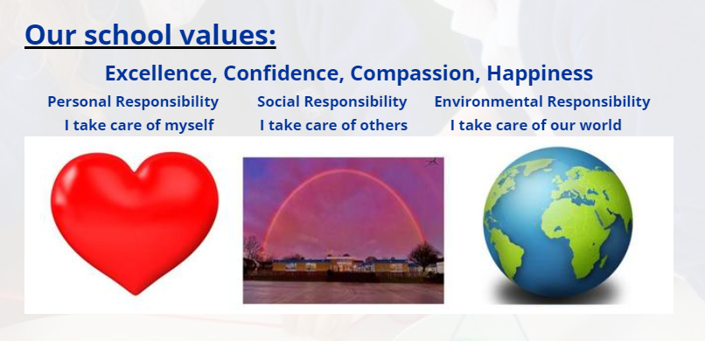
Behaviour
We will start the year creating our class code of conduct as well as reviewing the rules and expectations. Our aim is to show our school values in everything we do!
Notes:
Wes

Slide 5
Uniform and resources
Uniform and bags:
School uniform is a royal blue sweatshirt / cardigan, white polo shirt with dark trousers, skirt or pinafore, (Blue gingham dresses can be worn in the summer). Children need to have smart, sensible and safe black or navy-blue footwear which is suitable for active playtimes as well as for wearing in the classroom. Sweatshirts/cardigan, and polo shirts, embroidered with the school name and logo can be bought throughout the year from school. These items (without logo) are available at good prices from a wide range of shops and supermarkets. Sports kit consists of plain shorts or skorts (of a suitable length) and house colour T shirt and indoor pumps, (T shirts with logos in the colour of your house team and pumps can be bought through school or alternatively plain colour T shirts from shops). A track suit and trainers for outdoor wear are also needed from Year 2 upwards. It will be assumed that children in different coloured tops have brought them to keep warm under coats for outdoor play and they will be asked to remove them and hang them in the cloakrooms after playtime.
PLEASE NAME ALL CLOTHING INCLUDING SHOES!
Bags: We ask that children in Key Stage 2 bring their belongings in a small bag that fits in their trays in order to save space in classrooms.
Jewellery: We ask that children do not wear jewellery for school as, when playing, it can be unsafe to wear. If a child has their ears pierced, we ask for studs only please. If these cannot be removed for PE, they will be covered with tape.

Slide 6
Communication
Westendschool@westendprimary.org.uk - email address for most correspondence
Westendprimary.org.uk – for overview of school life/policies/events etc
Parentmail- for forms, school wide letters, significant information shop, reporting absences
In person for 1:1 discussion – parent’s evenings, SEN meetings
Notes:
Helen

Slide 7
Homework
Set on a Monday to be returned by Monday
Usually following the format of:
Weekly
Maths task
SPaG/spelling task
reading task (we recommend that children try to read at least 4 times a week)
Additional tasks across the year related to wider curriculum
creative activities / research activities / school events and initiatives
Notes:
Wes

Slide 8
Keeping Healthy – food and drink
Water bottles (named) children have access to water throughout the day – no juice please
Fruit or vegetables only please. Children can eat their snack from home during morning break
School dinners or packed lunches. School dinners are changing. We will be able to let you know more in September.
Packed lunches – healthy food only please (no nuts).
Notes:
Helen

Slide 9
Keeping healthy - P.E
We do two formal PE lessons per week as well as additional physical challenges and activities throughout the week.
Please make sure you child has the correct kit for their PE lessons.
For the first term, the class PE day will be confirmed in September.
Trainers, plain blue or black jogging bottoms or plain blue or black shorts, house colour t-shirt and jumper / hoody for outdoor PE (no jewellery, hair tied up please)

Slide 10
Keeping Healthy – Mental Health
Zones of Regulation
Mindful Activities
Check-ins and trusted adults
Pupil Voice
Learning Outside
Working with you!
Notes:
Helen

Slide 11
Coming Up This Year…
Christmas concert
Class celebration events and assemblies
Visits and visitors (there are costs linked to some of these) – Gurdwara and Peace Museum workshop
Whole school themed days and weeks
SATs (these take place in May further information will be shared with parents ahead of these)
Sports day and sporting events
Notes:
Wes

Slide 12
Our Curriculum – key skills
We focus on all times tables in Year 5 – for most this is revision knowledge to keep skills warm.
We will be learning spellings from the Y5/6 word. Teamwork, debating skills, analysing and evaluating are central skills in the foundation subjects studied in Year 5.
Notes:
Wes

Slide 13
Our Curriculum – overview
Over the course of the year we will be covering a broad and balanced curriculum. The overview map can be found on our class page of the school website.
Notes:
Wes

Slide 14
How we will support your child
Visual prompts and displays around the classroom
Differentiated activities
Practical resources
Dyslexia friendly colour schemes and lay out
Analysis of assessment information to identify learning gaps
Small group and 1:1 work to pre teach tasks / recap work
Personalised support plans (IPMS - these will be established in partnership with parents if needed)
Notes:
Wes

Slide 15
How we will challenge your child
Differentiated activities
Questioning to support deeper understanding
Task extension activities (yellow box challenges)
Using skills to explain to others / demonstrate reasoning
Notes:
Wes

Slide 16
We are really looking forward to teaching your child next year!
Thank you!
Notes:
Wes

