Slide 1
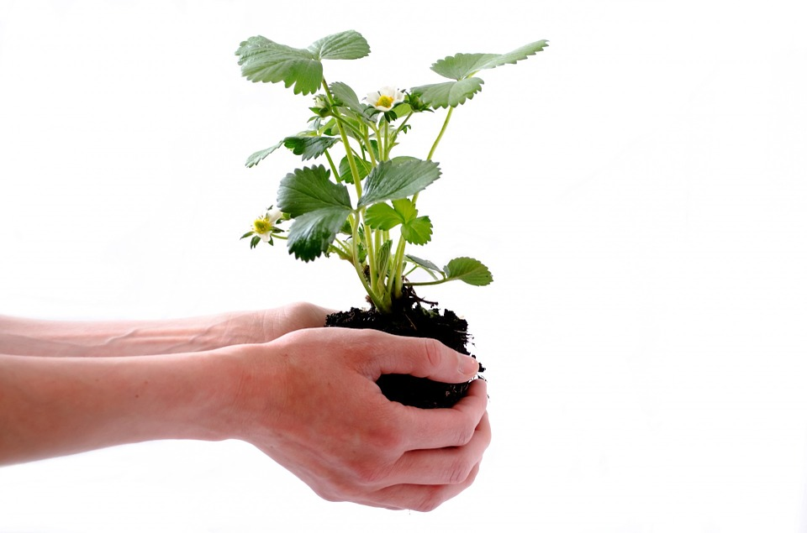







Lapwing Class Termly Topic Tasks
Follow your interests and choose two topic tasks to complete over the half term (four per term). You can complete them when it suits you best and bring them into school to share and celebrate with the class. How you present your project is up to you so be as creative as you can. For example, you could make models, draw, and write creatively; use technology; bake and cook; carry out interviews; take photographs or go on trips and visits to places of interest. We look forward to seeing your completed projects.
Rocks and Soils Plan an investigation to find out which type of soil is the best for growing a plant. | Physical Health Keep an activity diary for a week and see how active you are. Can you beat yourself in the following week? | South America and the Rainforest Create a fact file about a different rainforest. How does it compare to the Amazon? | Map Skills Create a map of the UK. How many counties can you name? Can you label any forests in the UK?
Wandering Artist Sketch an animal that you would find in a forest in the UK. How is it different to an animal from the rainforest? | Keeping Safe Think about road safety and create some ‘top tips’ for children walking home from school in the winter. | Gymnastics Research a famous gymnast. What is their event? How did they achieve their goals? | Celebrations Can you make some food that someone would eat as part of a celebration?

